Slide 1

Housing Prices in Boston
Predicting Housing Prices

Slide 2
Audience
Realtors
Potential Buyer and Seller

Slide 3
Problem Statement
Unsure of prices in the housing market.
Able to predict prices accurately to attract buyer
Buyers have a good idea what type of house they get with the specific range.

Slide 4
Data
Boston Housing Data Housing set was taken from Kaggle.

Slide 5
Exploratory Data Analysis
There are 80 different Columns ( variables)
2930 different data points.
There are categorical and numerical variables in the data set.
Categorical data can range from 2 options to about 6 options all describing the quality or features of the house.
The average sales price is $180,796.00 The most expensive sales price in this data set is $755,000

Slide 6
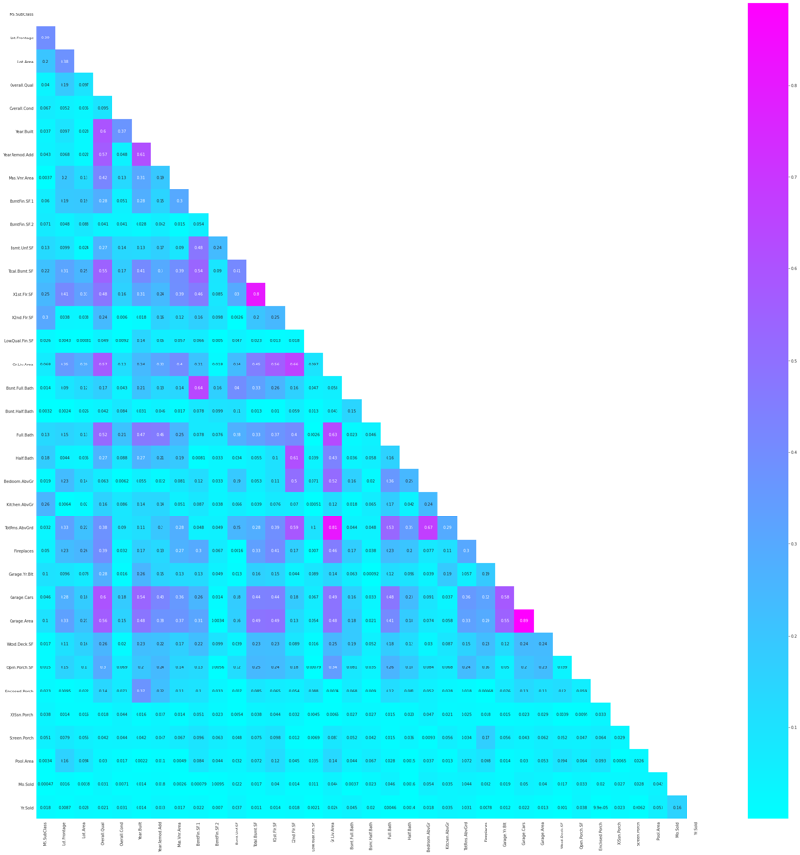
Exploratory Data Analysis
Looking at Correlations between SalePrice and the other variables.

Slide 7
Preprocessing
Cleaning Data
Normalizing data

Slide 8
Data Cleaning – Data that was removed
Variables with over 90% null values
Variables that have over 95% correlation with Sale Price
Variables that are under 1% correlated with Sale Price

Slide 9
Filling in Null Values
Variables with categorical values null values were substituted with 0 or their categorical counterpart of 0
Variables with null values that contain a numerical values would be filled with the mean.
Notes:
I would explore variables that are categorical and then replace null values depending on the type of categorical variable it is. The null value replaced will always be the null equivalent of the category. For example Garage type. If the house doesn’t have a garage I will create a new variable no garage and fill as such.

Slide 10
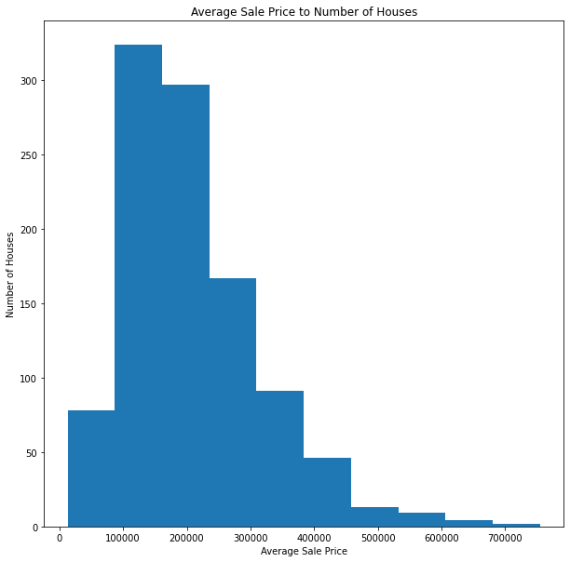
Normalizing the data set
Looking Sale Price the data was skewed towards the right.

Slide 11
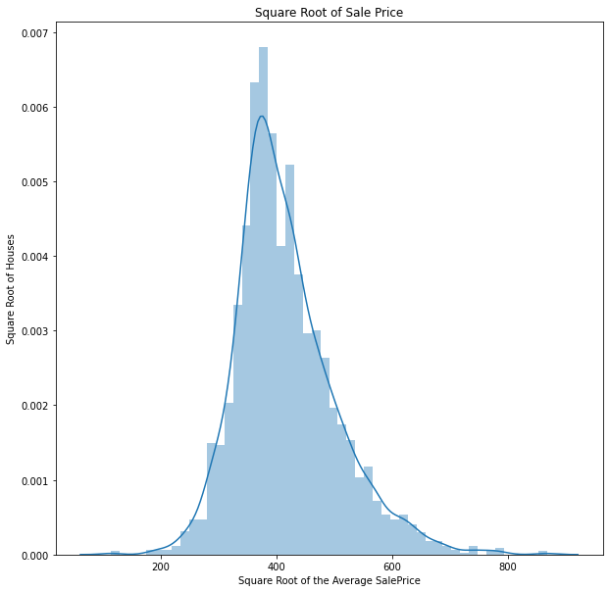
Sale Price
Taking the Square root of Sale Price improved the distribution of the data.
Notes:
Although the data still looks skewed towards the left the skewness has changed.

Slide 12
Changing data types
Changed all object items in to categorical data so that it can be converted into dummie variables.

Slide 13
Models and Model Processing
Models used to predict Sales Price:
Ordinary Least-Squares Regression
Linear Regression
Lasso
Ridge
Elastic Net
Gradient Boosting Regressor
Random Forest Regressor
Notes:
An example of a linear regression would be presented but by looking at the data’s distribution and since the data is not normal the results were not good.

Slide 14
Model Metrics
 | Explained Variance (r^2 score) | mean^2 error | root mean^2 error | mean absolute error
Linear Regression | -1.14E+21 | 8.36E+24 | 2.8921E+12 | 1.1149E+11
Ridge | 0.917 | 605.997 | 24.617 | 16.968
Gradient Boosting Regressor | 0.909 | 664.556 | 25.779 | 17.445
Random Forest Regressor | 0.901 | 727.977 | 26.981 | 18.304
Lasso(alpha=95) | 0.919 | 595.885 | 24.411 | 16.791
ElasticNet(ratio=.95) | 0.917 | 605.997 | 24.617 | 16.968
Notes:
Lasso Regression performed the best which makes sense since we have many variables to consider while running the model. Lasso would shrink the variable selection until it minimizes the prediction error. Even with Lasso’s explained variance is at 91% the mean square error is quite large. It is smaller than the mean of our data set but it causes a range of possibilities when predicting.

Slide 15
Future Recommendations and Next Best steps
Minimize the variance of Sale Price by creating a new variable with a range of prices.
Find the top 10 variables that contribute the Sale Price
Collect more data

